Slide 1

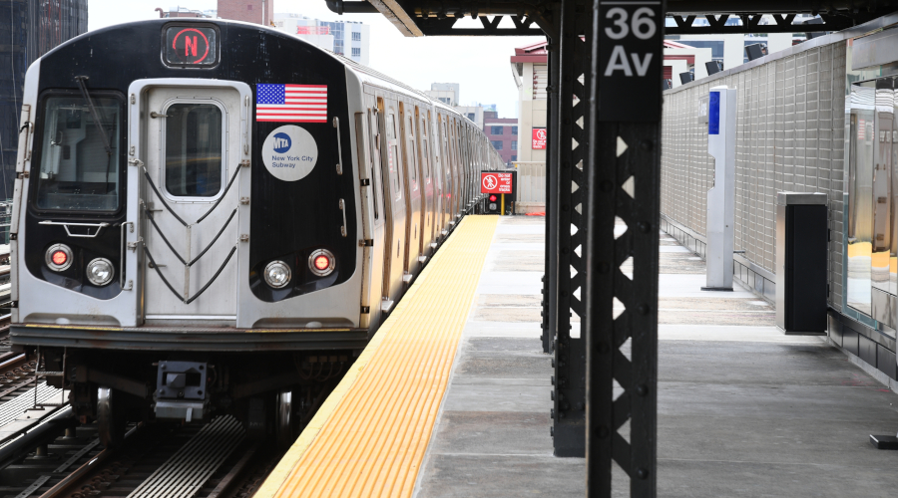

MTA DAILY RIDERSHIP ANALYSIS PROJECT
Analyzing Transportation Patterns Across the World's Largest Transit Network

Slide 2
Team Members
Hebat Allah Magdy
Nada Farid
Howaida Essam
Osama Mahmoud
Mennat Allah Beshr
Sara Osama

Slide 3
Table of Contents
Introduction
Data Cleaning & Preprocessing
Data Modelling
Analysis Questions
Visualizations & Insights
Predictions
Sources of Data
Project Steps Overview

Slide 4
Introduction
This project explores the MTA Daily Ridership dataset, which captures how millions of New Yorkers move across subways, buses, commuter rails, ferries, and bridges every day
By applying data analysis techniques, we aim to uncover patterns, measure shifts in travel behavior, and provide insights into how ridership has evolved—especially in comparison to pre-pandemic levels.
Our goal is to turn raw transportation data into clear, actionable insights that highlight the scale and dynamics of North America’s largest transit network.

Slide 5
Sources of Data
Table Name | Format | Source | Overview
MTA Ridership | Csv | DEPI | Provides raw data about different MTA modes Estimated Ridership and the % Change from Pre-Pandemic
NY_Cities_Coordinates | xlsx | https://simplemaps.com/data/world-cities | Provides NY Cities names and coordinates
Incidents | xlsx | https://data.ny.gov/Transportation/MTA-Metro-North-Major-Incidents-Beginning-2022/s3yp-8c47/about_data | Provides data about incidents that may affected ridership
Weather | csv | https://www.visualcrossing.com/weather-query-builder/ | Provides weather insights
Events | xlsx | https://www.mta.info/schedules https://www.mta.info/press-release/mta-announces-christmas-and-new-years-holiday-service | Provides Major Natural Disasters Events
Served_citites | xlsx | https://www.mta.info/accessibility/stations | Provides cities and their MTA Modes

Slide 6
Steps
Data Wrangling
Quality Issues
Tideness Issues
Data Modeling
Added Data
Star Schema
Planning
High-Impact Questions
Pages/Visuals Design
Relationships
Execution
DAX
Prediction
Creation of Reports/Visuals and Dashboard
Presentation of Key Insights

Slide 7
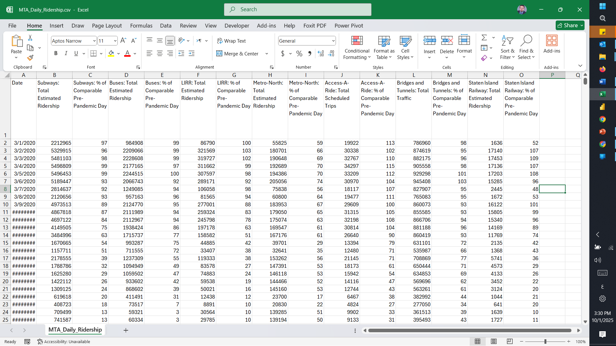
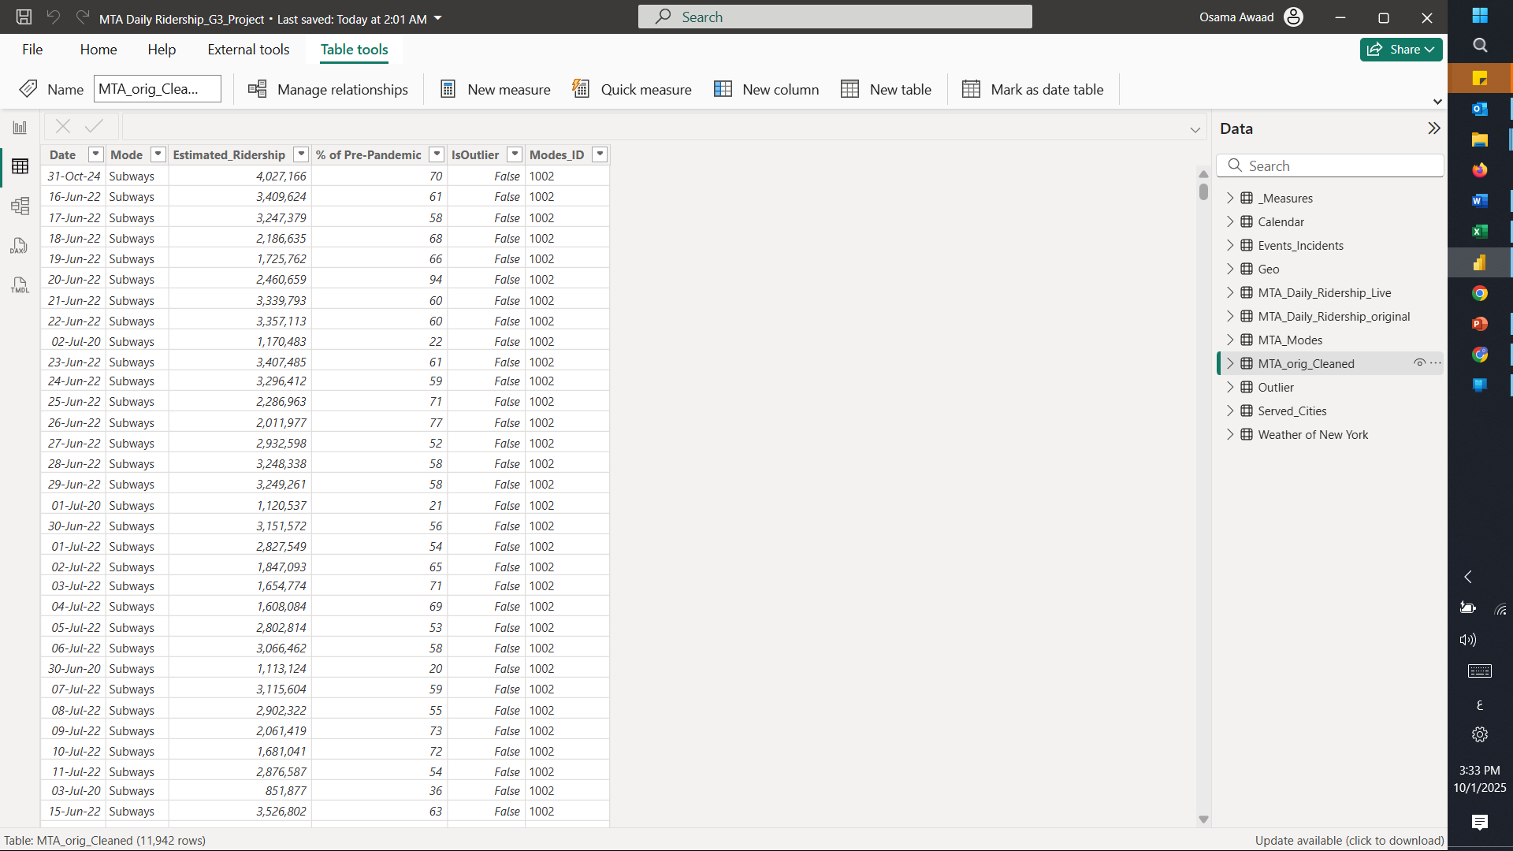
Cleaning
Before
After

Slide 8
Data Wrangling Process
Unpivoting ridership count data
Unpivoting percentage difference data
Merging datasets for comprehensive analysis
Data quality checks and outlier detection
Enriching data with weather, events, locations, and mode-city mappings

Slide 9
Data Quality and Tidiness Checks
Checked Each Column For Missing Or Invalid Data
Verified Consistent Data Types And Trimmed Text Where Applicable
Outlier Detection Using Statistical IQR Method
Evaluated Outliers In Context With External Data Sources

Slide 10
Data Enrichment
Added daily weather data to capture environmental impacts
Merged incidents and major event data to explain anomalies
Included geographic data (longitude, latitude) for visualization on Power BI maps
Created a mapping table linking MTA modes to NY cities to support relational analysis

Slide 11
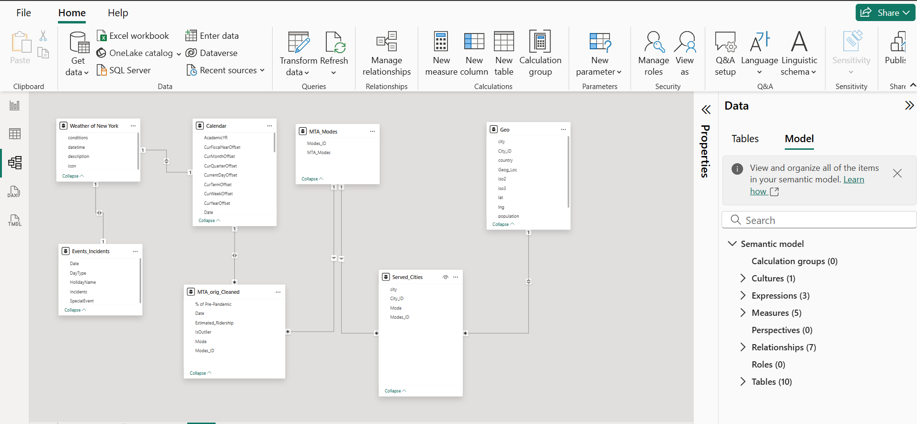
Data Modeling

Slide 12

Analysis Questions

Slide 13
Analysis Questions
Has ridership returned to pre-pandemic levels? If not, which mode recovered the fastest?
Is there a difference between weekdays and weekends?
Which stations or lines have shown the highest growth since 2021?
Evolution and Comparison between total ridership for each mode
What is the expected ridership trend over the coming months or years for each transportation mode?
Is the daily ridership increasing or decreasing over time?

Slide 14
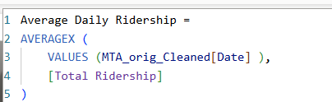
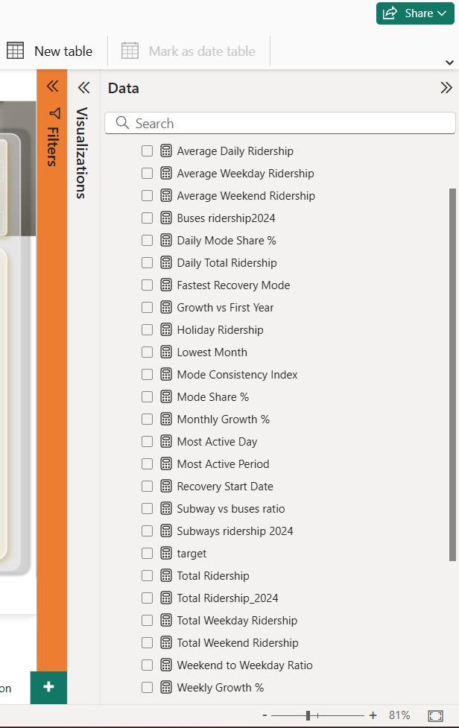
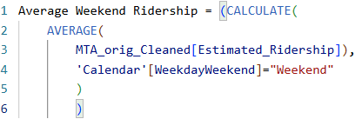
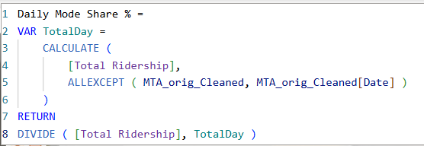
Dax

Slide 15
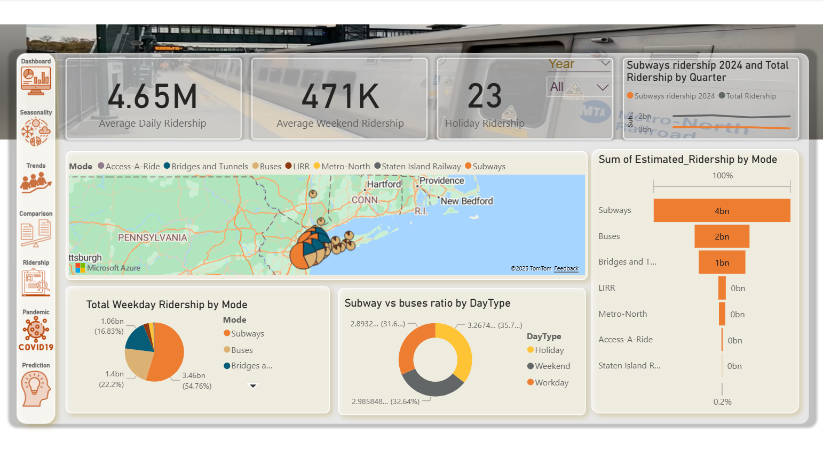
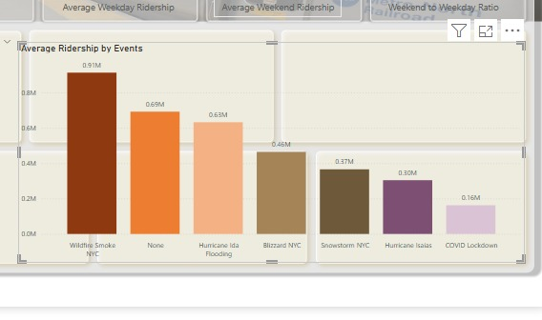
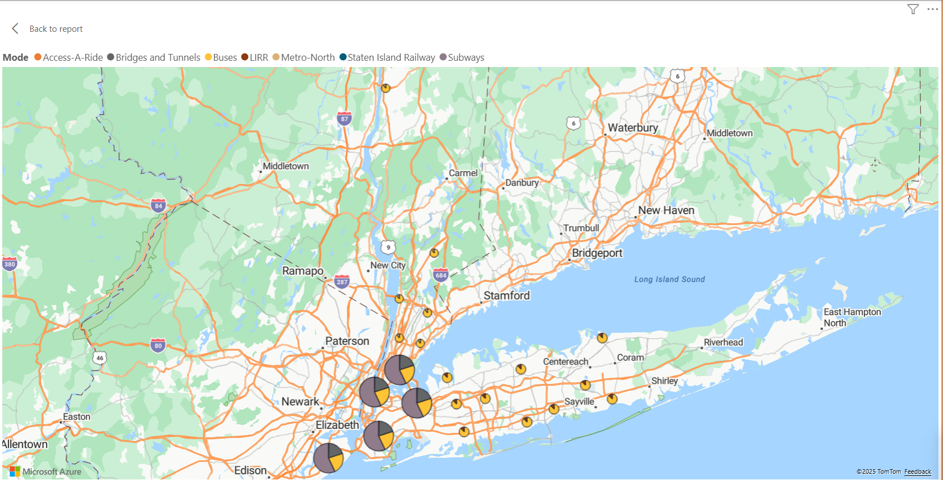
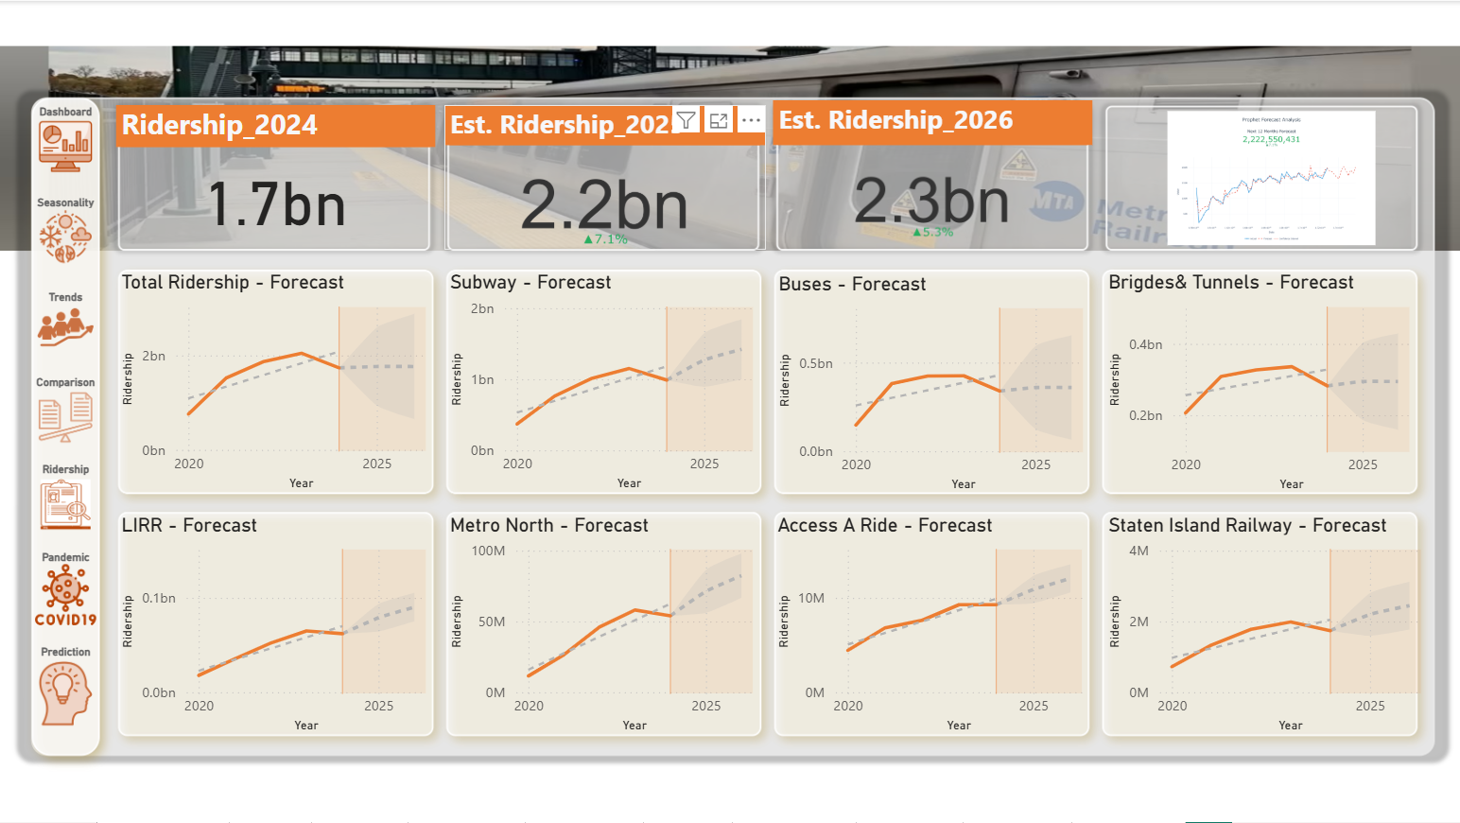
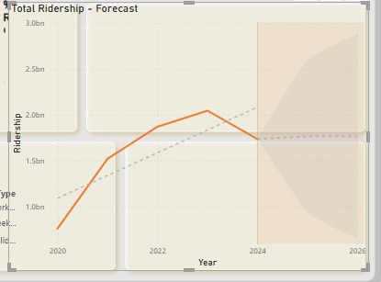
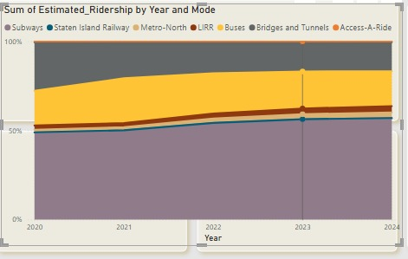
Sample Visuals

Slide 16

Ridership

Slide 17

Seasonality

Slide 18
Trends

Slide 19
Comparison

Slide 20
Pandemic

Slide 21
Prediction

Slide 22
Dashboard

Slide 23
Thank you

